Slide 1
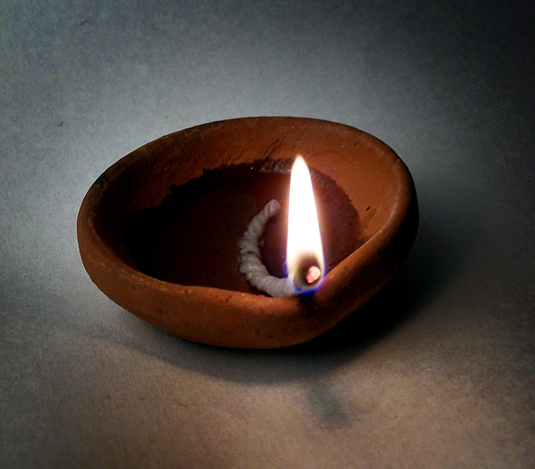
Tihar Celebration and Cultural Show

Slide 2
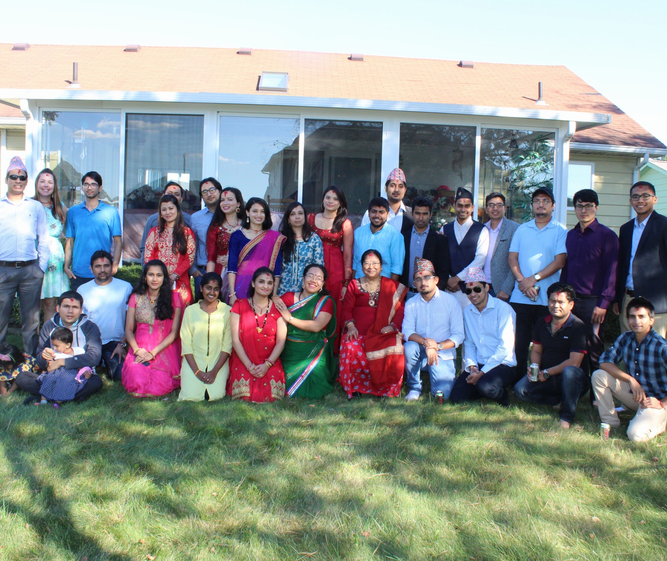
Welcome Speech
Manoj Baniya
President
Nepal Students’ Association

Slide 3


Slide 4


Slide 5
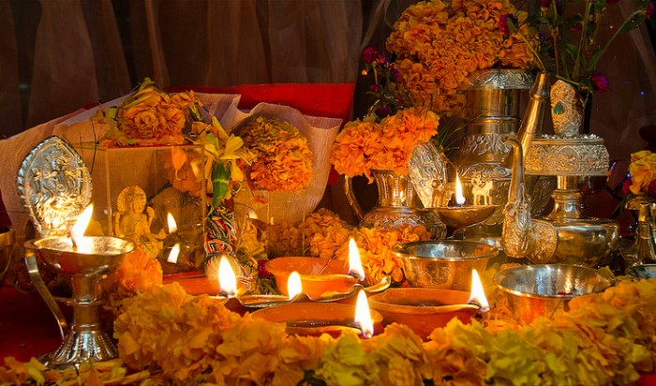
Tihar Festival

Slide 6
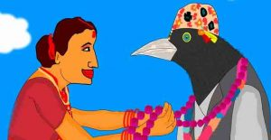
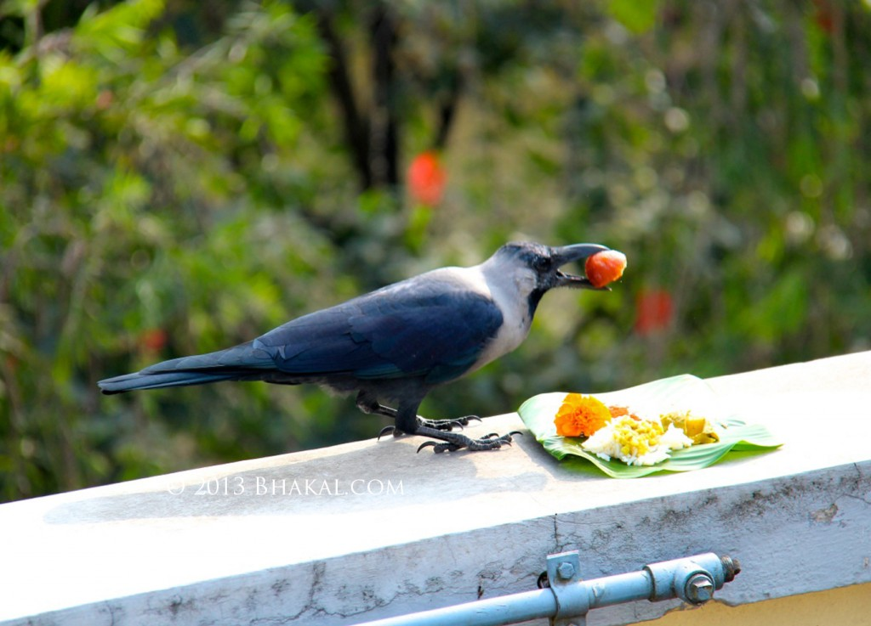
Kaag Tihar (Day 1)

Slide 7
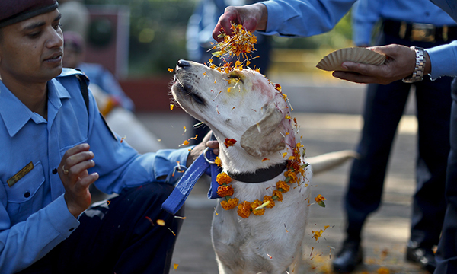
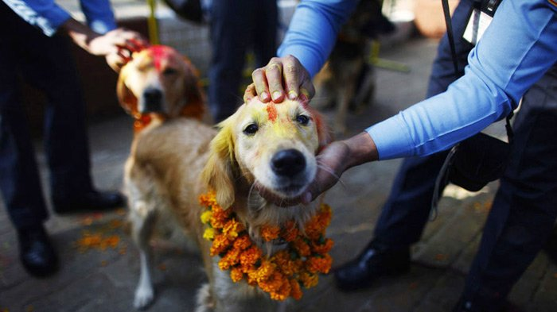
Kukur Tihar (Day 2)

Slide 8
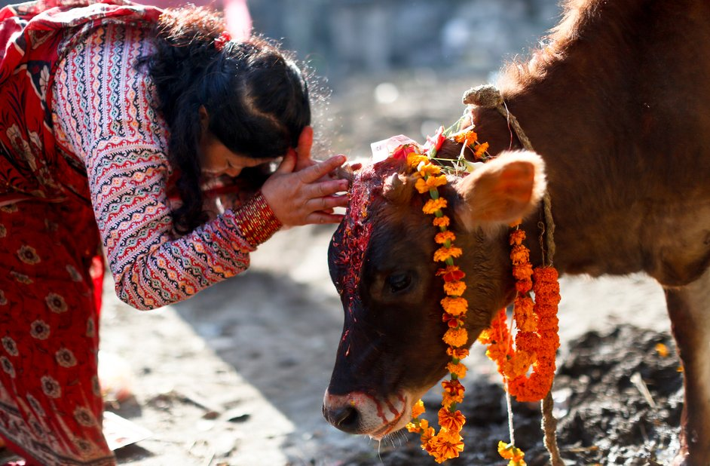
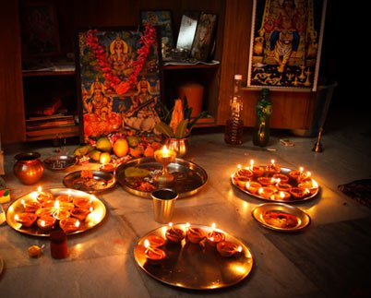
Gai Tihar and Laxmi Puja(Day 3)

Slide 9
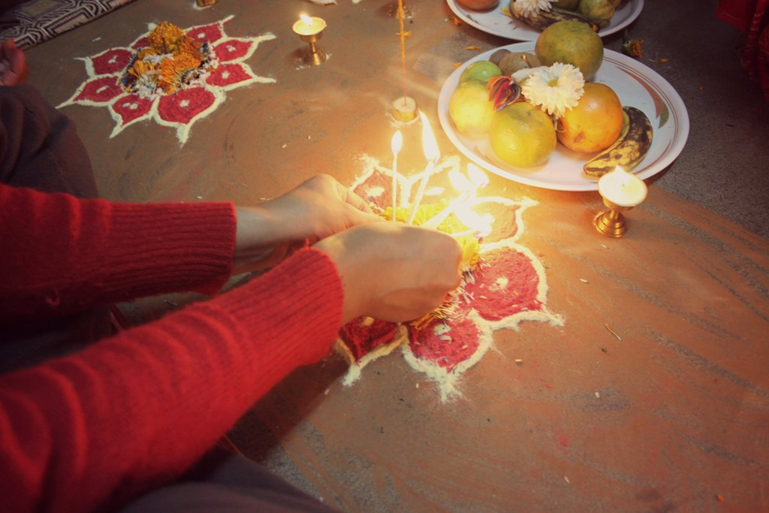
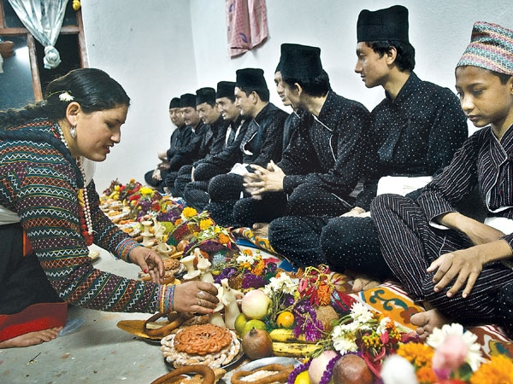
Mha Puja(Day 4)

Slide 10
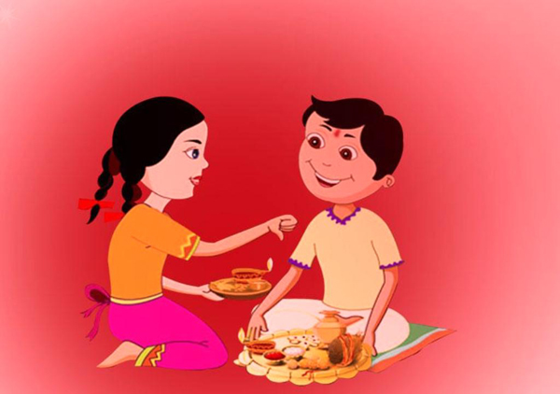
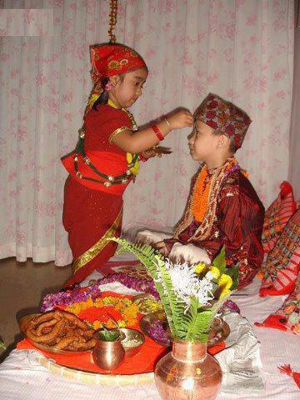
Bhai Tika (Day 5)

Slide 11
Quiz 1
What is the capital city of Nepal ?

Slide 12
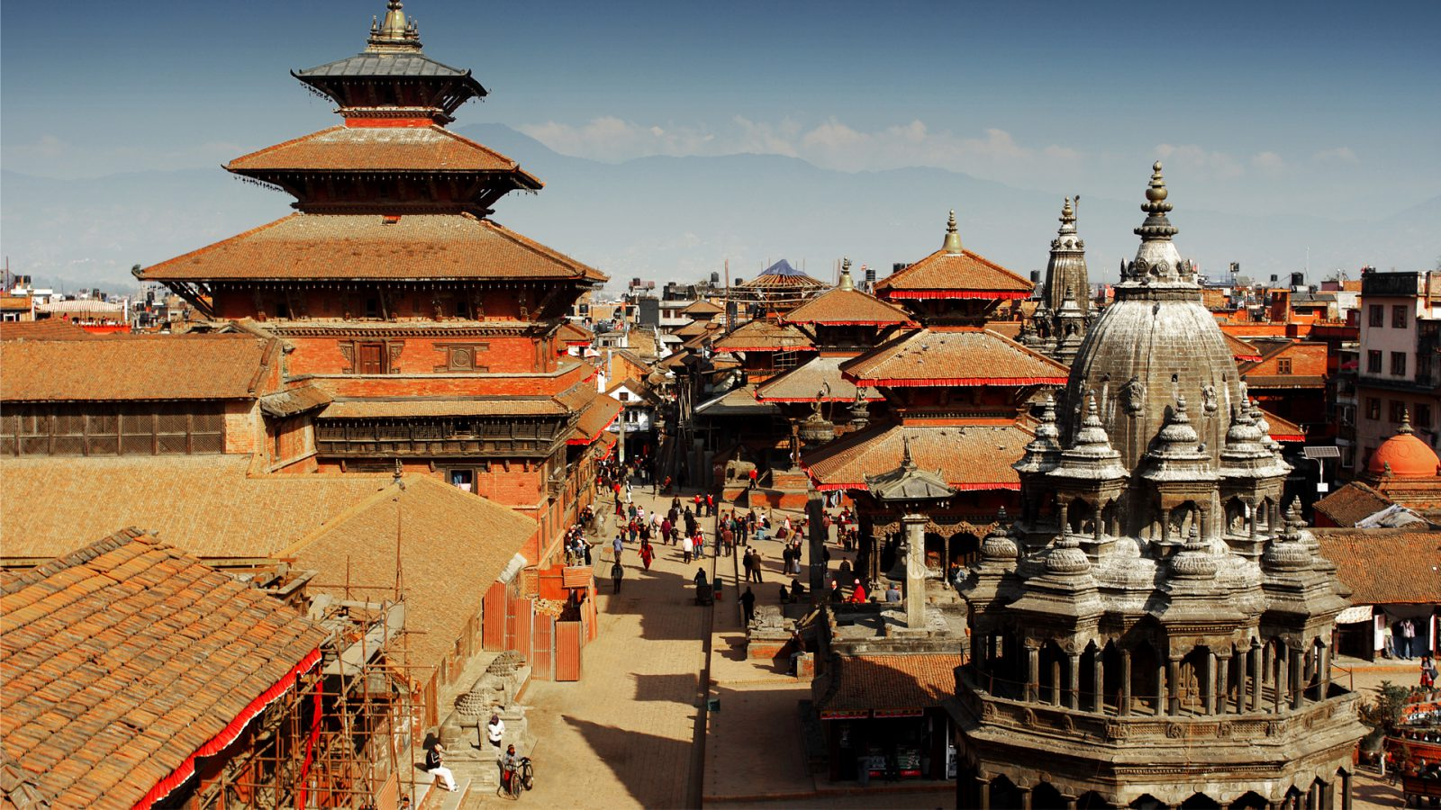
Answer: Kathmandu

Slide 13
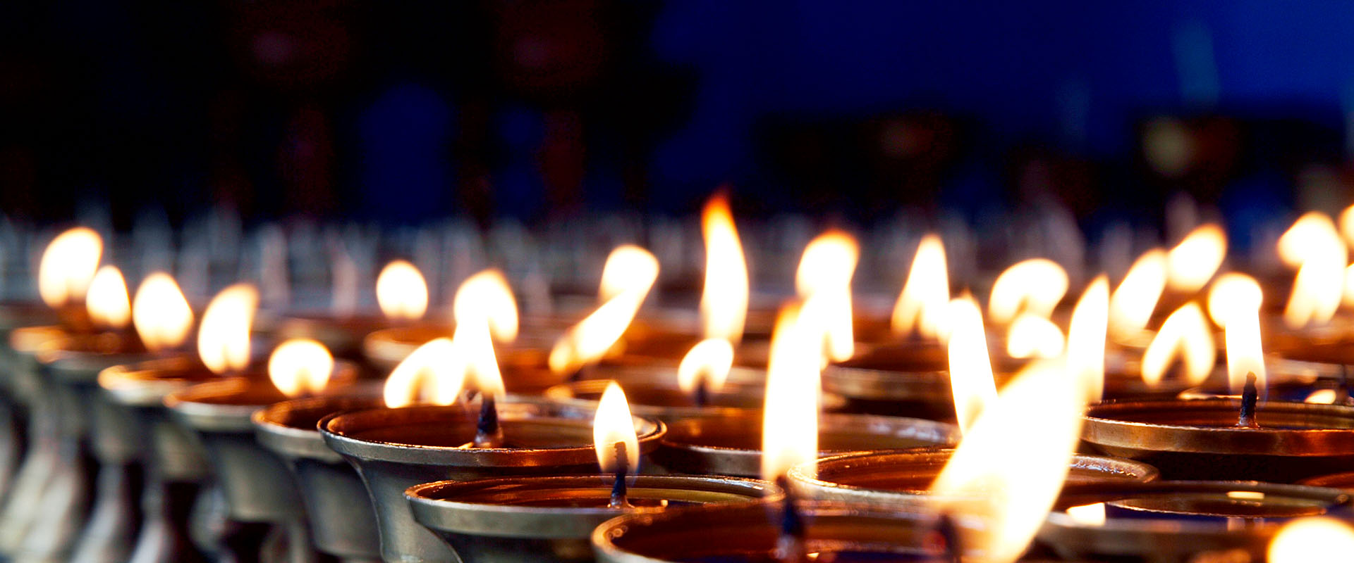

Slide 14
Poetry
A Promise, Broken
Shiva Bhusal

Slide 15
Poetry
A father to his new-born daughter
Shiva Bhusal

Slide 16
Dance Performance: Nepalese Boys
Gaurav Sitaula
Gokul Dhakal
Manoj Baniya
Prabin Dulal
Pradip Kandel
Sagar Sharma
Choreographer: Yubaraj Rana

Slide 17
Quiz 2
What is the currency of Nepal?

Slide 18
Answer
Nepalese Rupee

Slide 19
Dance Performance: Sri Lanka
Madhu Adhikari

Slide 20
Quiz 3
Which is the tallest mountain on Earth ?

Slide 21
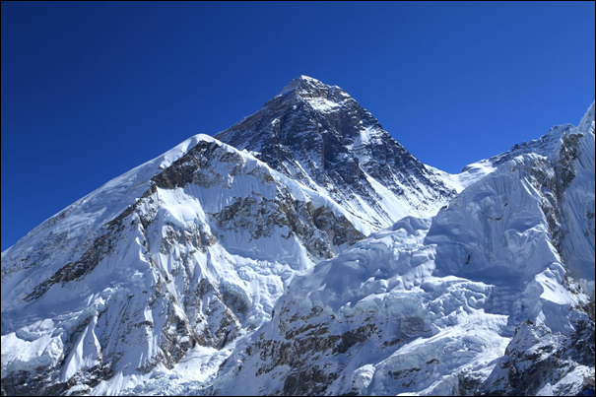
Answer: Mt. Everest or Sagarmatha

Slide 22
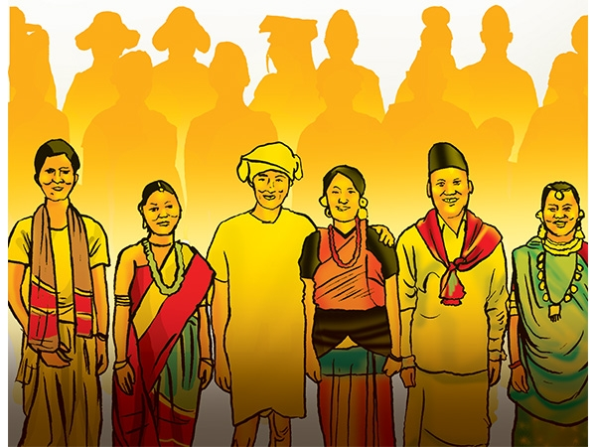
Add a nepali theme photo here

Slide 23
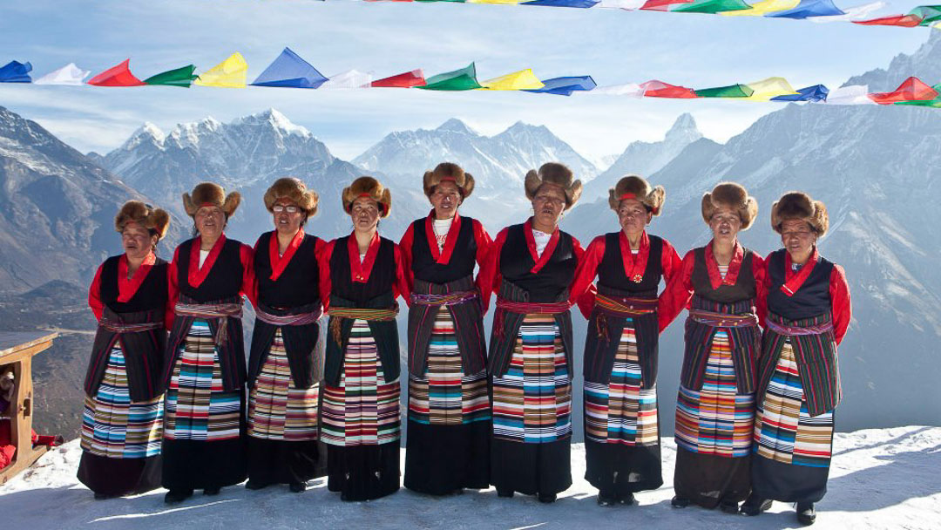
Sherpa: People from the Mountain

Slide 24
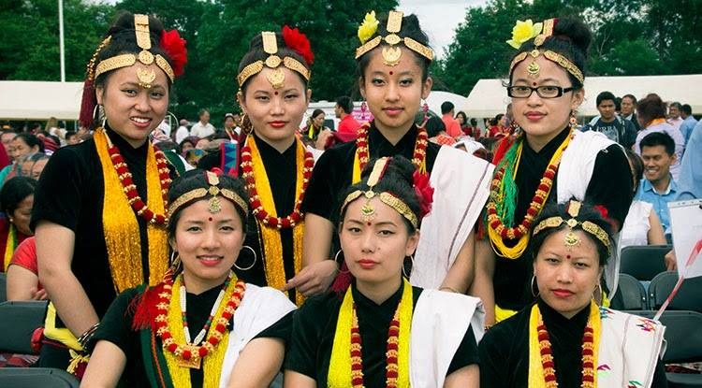
Magar: People from the Hills

Slide 25
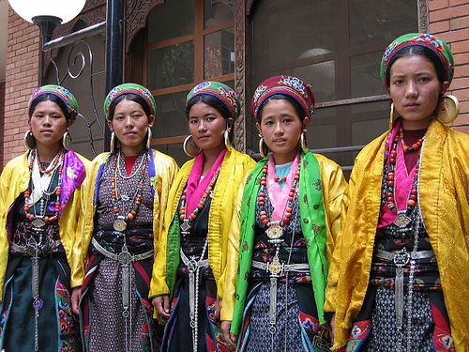
Tamang: People from the Upper Hills

Slide 26
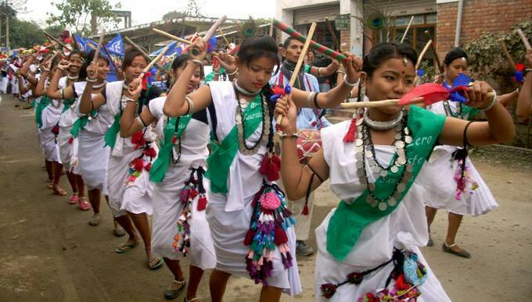
Tharu: People from Terai(Plains)

Slide 27
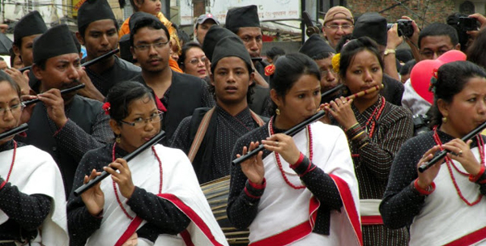
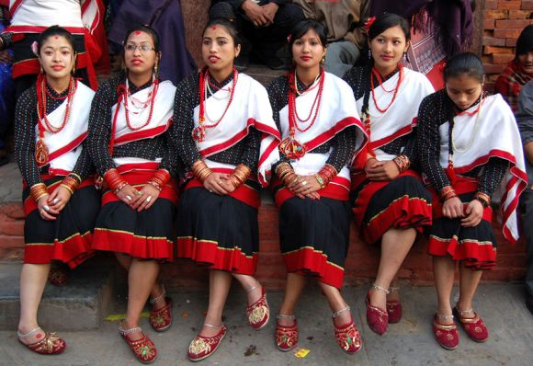
Newar: People from Kathmandu Valley

Slide 28
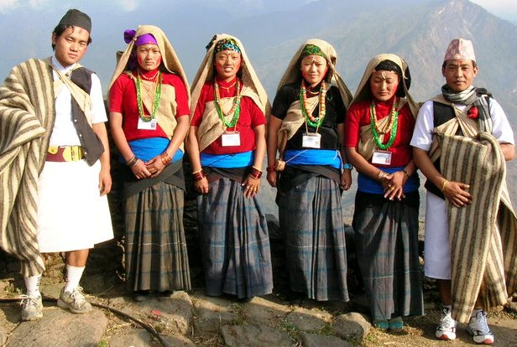
Gurung: People from the Hills

Slide 29
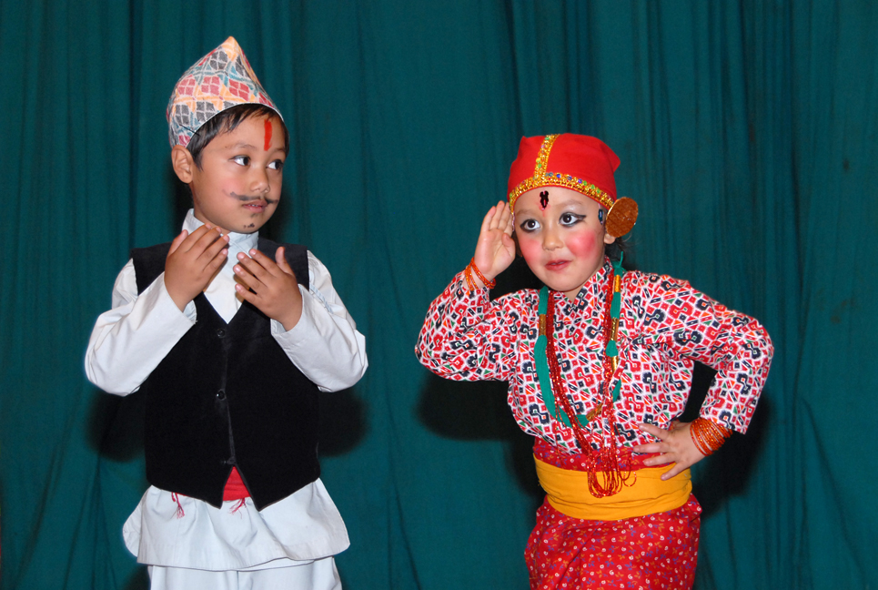
National Dress of Nepal

Slide 30
Quiz 4:
Which country lies to the South of Nepal ?

Slide 31
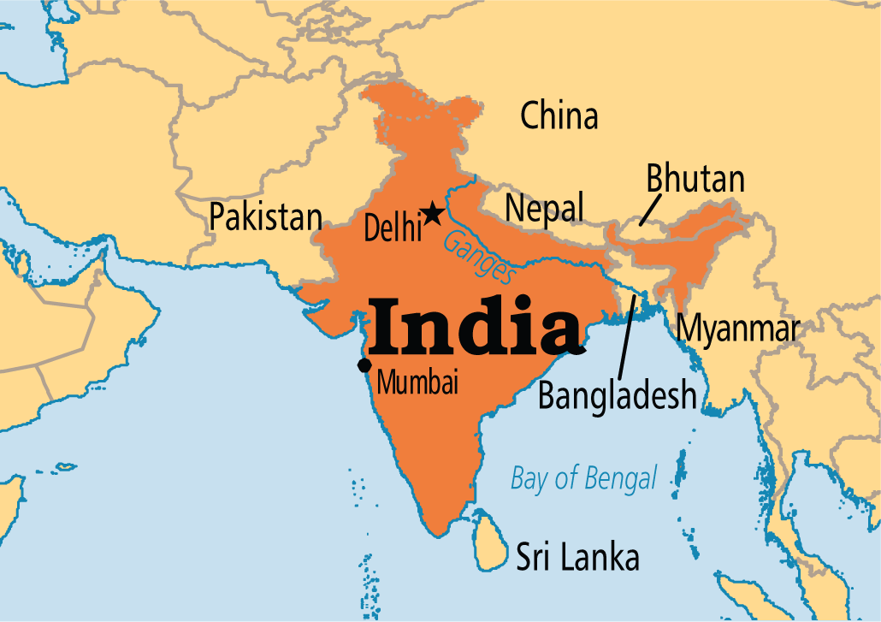
Answer: India

Slide 32
Dance Performance: India
Nitin Odedara

Slide 33
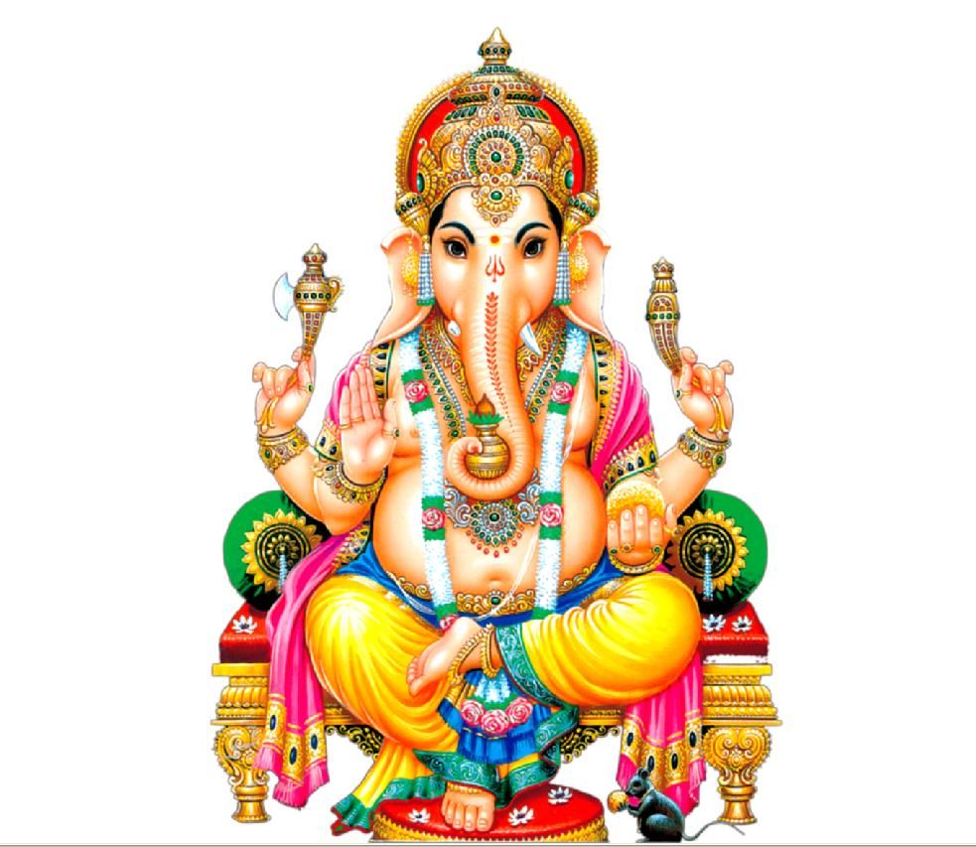

Slide 34
Dance Performance: University of Toledo
Sushmita

Slide 35
Quiz 5
Who is known as the light of Asia ?

Slide 36
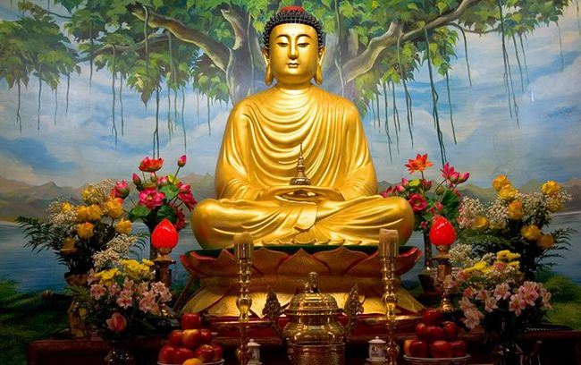
Answer: Gautam Buddha

Slide 37
Nepalese Song
Kumud Joshi
Sudhan Pachhain
Song Title: “Jaha Chhan Buddha Ka Aankha”

Slide 38
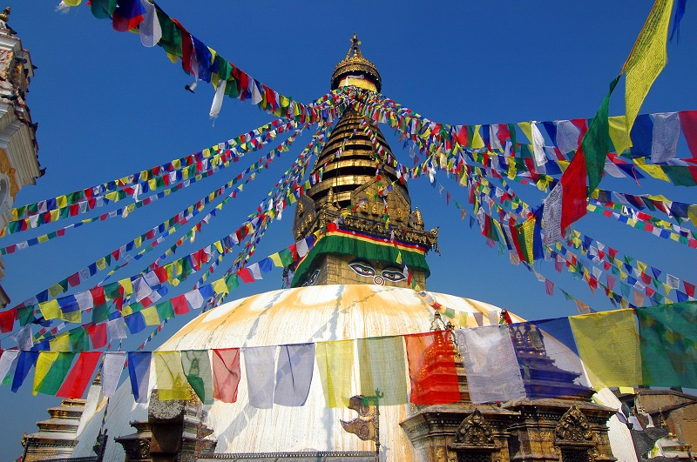

Slide 39
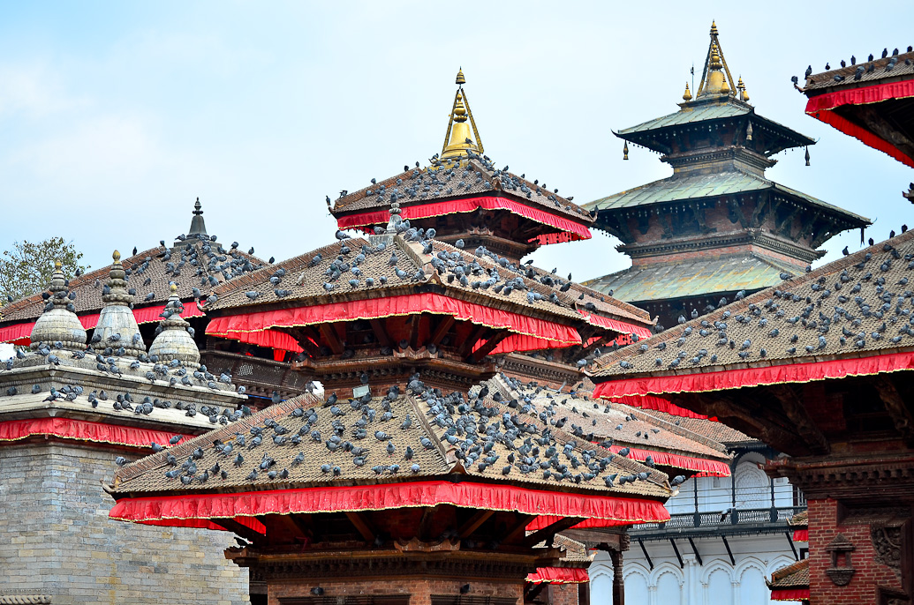

Slide 40
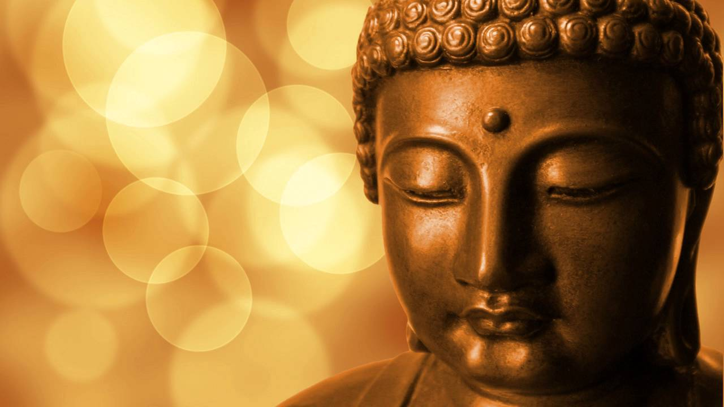

Slide 41
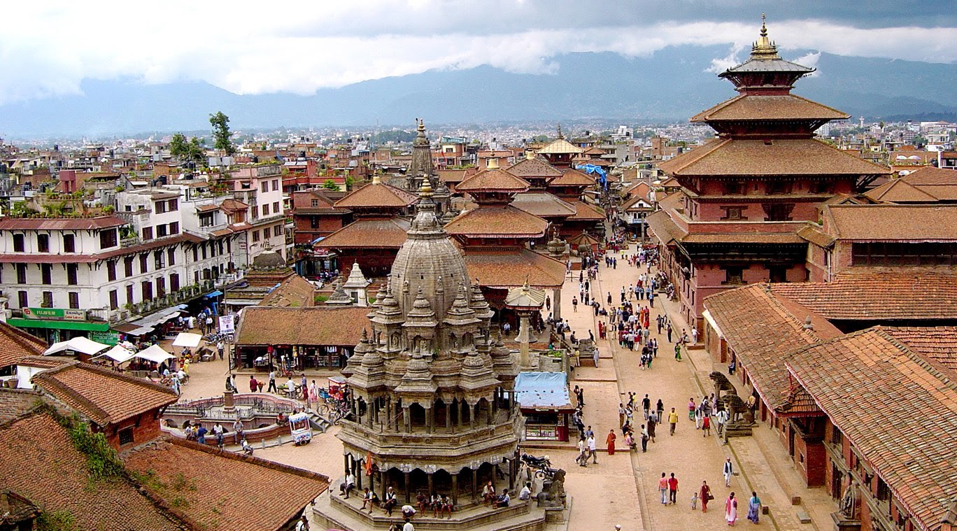

Slide 42
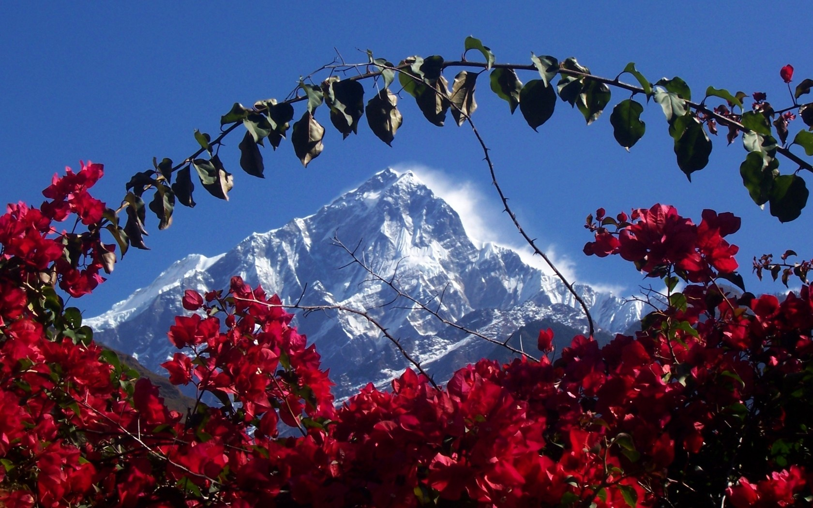

Slide 43
Dance Performance: Nepalese Girls
Jyotshana Gautam
Rajani Shrestha
Rakshya Khatiwada Silwal
Rita Subba

Slide 44
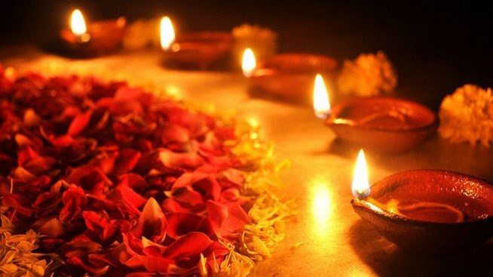

Slide 45
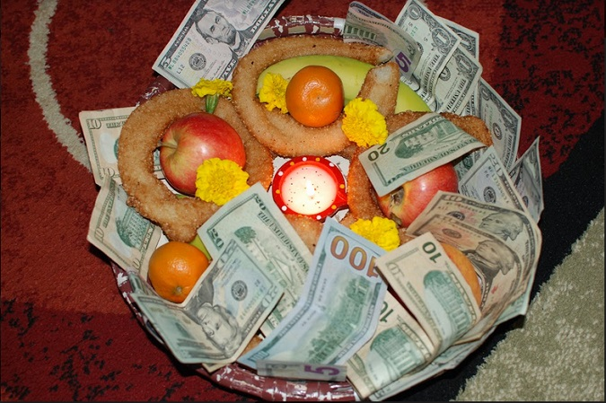
Dausi Bhailo

